Slide 1
ProgTeam: Week 2
Binary Search

Slide 2
Binary Search
Requires “monotonic” function
Once state changes, it should never back
Some examples: least/most number of elements, shortest distance
If we’re looking for the latest ‘1’, we can eliminate half of all options with one query
1 1 1 1 1 1 1 1 1 1 0 0 0 0 0 0 0 0 0 0 0 0 0 0 0 0 0 0 0 0 0 0 0 1 1 1 1 1 1 1 1 1 1 0 0 0 0 0 0 0 0 0 0 0 0 0 0 0 0 0 0 0 0 0 0 0 1 1 1 1 1 1 1 1 1 1 0 0 0 0 0 0 0 0 0 0 0 0 0 0 0 0 0 0 0 0 0 0 0 1 1 1 1 1 1 1 1 1 1 0 0 0 0 0 0 0 0 0 0 0 0 0 0 0 0 0 0 0 0 0 0 0 1 1 1 1 1 1 1 1 1 1 0 0 0 0 0 0 0 0 0 0 0 0 0 0 0 0 0 0 0 0 0 0 0 Total = Log(N) 1 1 1 1 1 1 1 1 1 1 0 0 0 0 0 0 0 0 0 0 0 0 0 0 0 0 0 0 0 0 0 0 0 queries

Slide 3
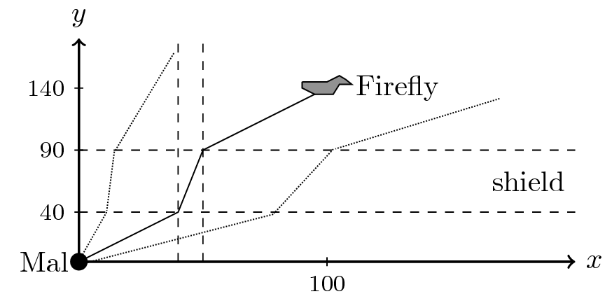
Careful Ascent [NWERC 2016] (Simplified)
https://open.kattis.com/problems/carefulascent
Mal is trying to get back to the mothership ‘FireFly’
His vertical velocity is fixed and unchangeable
His ship can pick one fixed ‘x’ velocity and will travel at this speed continuously
When his ship enters a shield, it will be slowed by a constant factor of F
What should Mal’s initial horizontal velocity be?

Slide 4
Careful Ascent [NWERC 2016] (Simplified)
Notice: for a larger initial ‘x’ velocity, Mal’s final ‘x’ coordinates will be larger
This means we can binary search!
If Mal’s final ‘x’ coordinate is greater than the Firefly’s, we know his velocity was too large

Slide 5
Careful Ascent [NWERC 2016] (Simplified)
Binary search with doubles:
Fine version, but could cause issues in some cases:
double lo = 0, hi = x;
while(hi - lo > 1e-7){ // Precision issues for very large numbers!
double mid = (lo + hi) / 2;
if(get_final_position(mid) < x){
lo = mid;
}else{
hi = mid;
}
}

Slide 6
Careful Ascent [NWERC 2016] (Simplified)
Binary search with doubles
More resilient version:
for(int i = 0; i < 100; i++){
double mid = (lo + hi) / 2;
if(get_final_position(mid) < x){
lo = mid;
}else{
hi = mid;
}
}

Slide 7
H-Index [RMPC 2018]
https://open.kattis.com/problems/hindex
You have a list of papers, each with A_{i} citations
The H-index of an author is the largest K such that an author has at least K papers with K citations
What is your H-index?

Slide 8
H-Index [RMPC 2018]
Can we binary search?
If there are at least 6 papers with 6 citations…. Clearly there are also at least 5 papers with 5 citations
So we can!
N is a valid candidate for the H-Index implies all of (1…N - 1) are too
1 1 1 1 1 0 0 0 0 0 0 ....

Slide 9
H-Index [RMPC 2018]
Binary Search with Integers
Two forms: be careful with which one you need!
int lo = 0, hi = n;
while(lo < hi){
int mid = (lo + hi + 1) / 2;
if(validate(mid)){
lo = mid;
}else{
hi = mid - 1;
}
}
int lo = 0, hi = n;
while(lo < hi){
int mid = (lo + hi) / 2;
if(validate(mid)){
hi = mid;
}else{
lo = mid + 1;
}
}
< ---------Find the minimum valid element
Find the maximum valid element --------->

Slide 10
H-Index [RMPC 2018]
In this case we want the maximum element:
int lo = 0, hi = n;
while(lo < hi){
int mid = (lo + hi + 1) / 2;
if(is_valid_h_index(n, mid)){
lo = mid;
}else{
hi = mid - 1;
}
}

Slide 11
H-Index [RMPC 2018]
Other strategies exist to keep track of binary searching
Here’s a strategy I used for a while
int lo = 0, hi = n;
while(lo < hi - 1){
int mid = (lo + hi + 1) / 2;
if(is_valid_h_index(n, mid)){
lo = mid;
}else{
hi = mid; // not mid - 1
}
}
//For minimum just do the reverse
while(is_valid_h_index(n, lo + 1)) lo += 1;

Slide 12
Binary Search: Closing Notes
In a lot of problems, answering the question
“Can we accomplish the task with K elements?”
is easier than trying to answer “What is the minimum value of K?” directly.
Binary search is most often used to turn a very difficult problem into a greedy one

